Slide 1
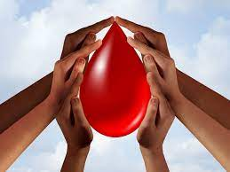
RAKTABīJ Don’t waste your blood, let new lives grow from it
Under Supervision of:
Dr.V.Deepika
Team Members:
Siddharth Linga (19B81A3347)
Sathwik Rachuri (19B81A3343)
Karthik Katakam (19B81A3317)

Slide 2
Outline
- Inspiration for our idea
- Need of the app
- Existing systems
- Proposed systems
- Technologies used in proposed system
- Features of our system
- Existing systems VS Proposed system
- References

Slide 3
INSPIRATION FOR OUR IDEA
A SAD STORY!!

Slide 4
Why is this app needed?
Blood is an essential component of our lives.
Due to unexpected events such as accidents or diseases we undergo blood loss.
Then comes the requirement of blood donors.
But how to find them in a limited time span?
Many people die due to lack of donated blood.

Slide 5
12,300
DO YOU KNOW HOW MANY PEOPLE DIE DUE TO LACK OF BLOOD DONORS?
Whoa! That’s a big number, and to add on these are the statistics of recorded cases only.
Source: INDIAN EXPRESS, HINDUSTAN TIMES

Slide 6
AROUND THE WORLD

Slide 7
Existing Systems
BLOOD DONORS
FRIENDS 2 SUPPORT

Slide 8
BLOOD DONORS
This application sends messages about the nearest blood camps to the registerd donors. This turned out to be one of the well working apps.
Limitations:
Only camps are mentioned here
No help offered in the case of emergency.
Many apps are a subset of this app.

Slide 9
Friends 2 support
This application is available in play store as well as a webpage online. Here it collects information from the recipients such as blood group, location etc.
Which results in displaying all the details of all the donors in the location.
GOOD INITIATION!!

Slide 10
BIG DISADVANTAGE
NO SECURITY TO THE DETAILS!!

Slide 11
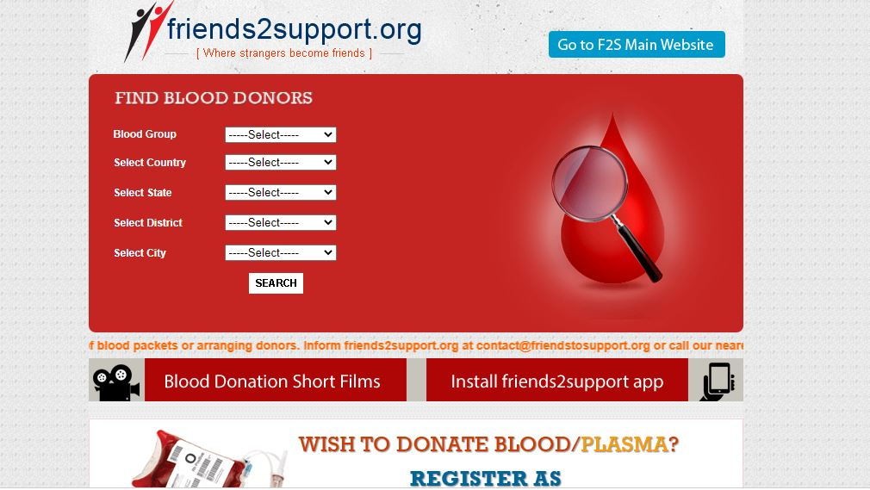

Slide 12
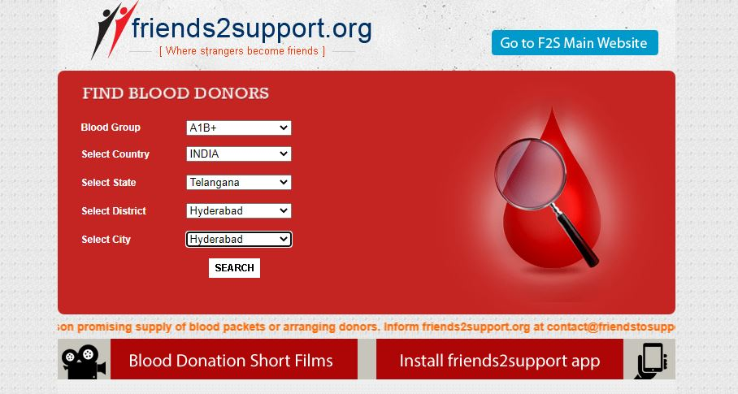

Slide 13
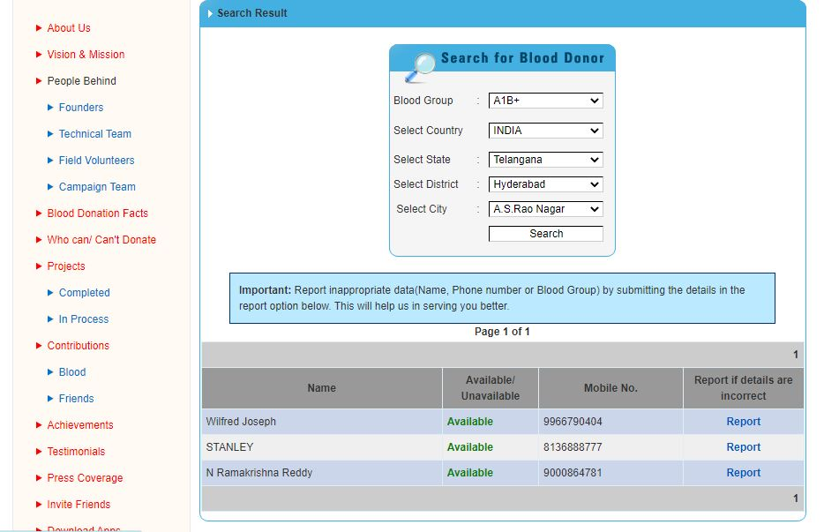

Slide 14
CASES OF ILLEGAL SALE OF BLOOD
Friends 2 Support
As the phone numbers of donors are available people contact them directly and offer price for selling blood.
Smuggling of blood is also a deep concern.

Slide 15
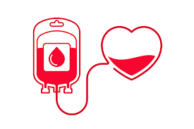
Proposed System
- When ever a recipient needs blood, he/she enters the details such as hospital admitted in , blood group required etc.
- It mails the details to the donors in the database with same blood group and in the location . Due to which we are providing security to the donors details.
- As mentioning the hospital name is mandatory, chances for illegal sale is reduced.

Slide 16
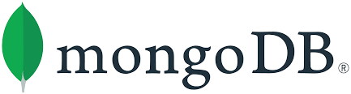


Technologies used
MongoDB
For storing and analyzing data.
NodeJS
User Server interaction
Modules used: express, http, MongoClient, nodemailer
HTML/CSS/JS
Front end and dynamic nature to the web pages.

Slide 17
Features in our Application
Dynamic database
High Security
Provides reporting feature for any suspicious activities
SAVES LIVES

Slide 18
Proposed System VS Existing System
 | Security for donors details | Chances for Illegal activities | Dynamic nature
Blood Donor | May be | Very less | Moderate
Friends 2 Support | NO | High | High
Raktabīj | HIGH | Very less | High

Slide 19
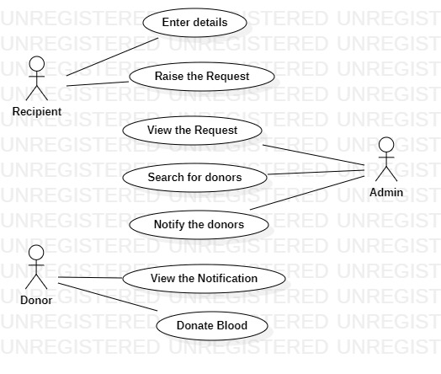
Use Case

Slide 20
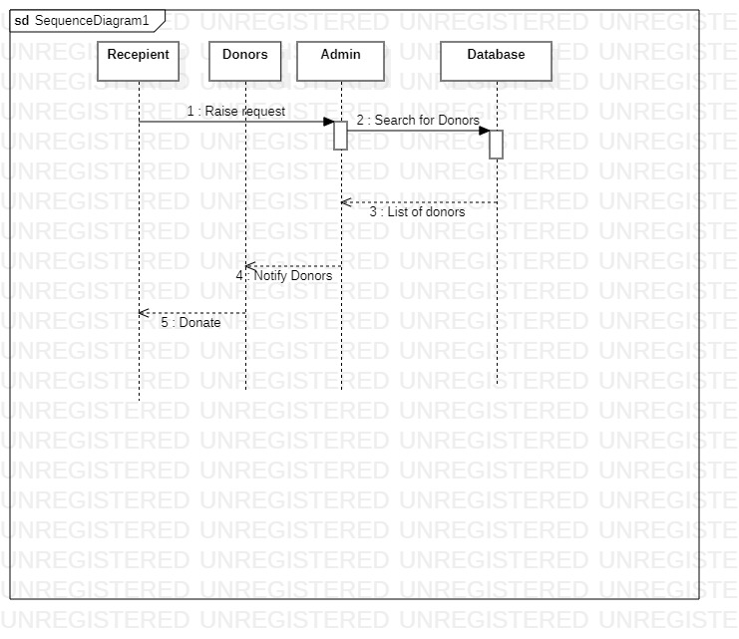
Sequence Diagram

Slide 21
References
Indian Express, Hindustan times for research
www.blooddonationapplications.org for existing systems

Slide 22


Slide 23
THANKS
Any questions?

